Slide 1
PROJECT IN MS-EXCEL:
Done by Ramprabhu.G
On 02.10.2023
Actively participating in “GROW DATA SKILLS”-
”DATA ANLYST BOOTCAMP 1.0”from July’2023

Slide 2
Client wants to create a Road Accident Dashboard for year 2021 to 2022 so that they can have insights on the below requirements:
Total Casualities taken place after the accident
Total casuaities & percentage of total with repect to accident severity and maximum casualities by type and vehicle
Total Casualities with respect to vehicle types
Monthly trend showing comparison of casualities for current year and previous year
Maximum Casualities by Road Type
Distribution of total Casualities by Road Surface
Relation between Casualities by Area/Location & by Day/Night

Slide 3
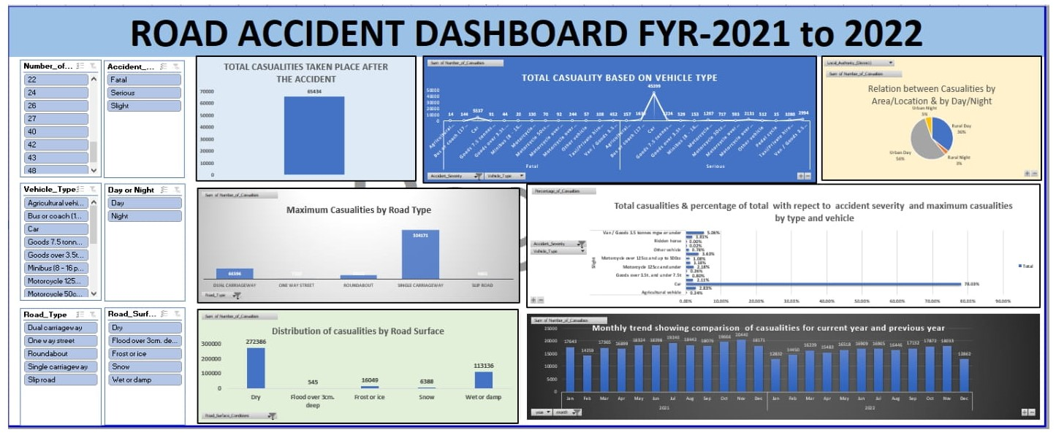

Slide 4
PROJECT STEPS:
DATA CLEANING :Remove Duplicates and avoid blanks.
DATA TRANSFORMATION :As per the requirements.
DATA REQUIREMENTS:Solve the each and requirements in the separate sheet.
DATA VISUALIZATION:Using charts visualize the data.
TOOLS / COMMANDS USED:
Pivot table used to show the summarized values for the required fields.
Bar plot,Pie Plot,Column and Line plot used for the “Data Visualization”.
Slicers added to visualize in the required timeline.(Ex:Month,Year)

Slide 5
Project Conclusion:
Total Casualities taken after the accident :65434 incidents.
“CAR” comes under the most impactful vehicle type created casuality :45399 incidents(78.03%).
Maximum accidents happened in the “URBAN AREA”56% in the”Day”.
Most casuality happened Single carriageway roadway :304171 incidents.
Maximum casuality happened “Dry Surface”:272386 incidents.
Comparing with year 2021 and 2022:Highest casuality happened in the month of Nov’2021:20440 incidents

